Slide 1
The Role of Context in Memory Storage and Retrieval -- Insights from Recognition and Recall Studies through Computational Modeling
Lea (Shuchun) Lai, Indiana University
Committee members: Richard Shiffrin, Rob Nosofsky, Jerome Busemeyer, Michael Trosset
Sep 6, 2024

Slide 2
Memory Components
Memory Components
Content: Specific details distinguishing one memory from another.
Context: Situational details surrounding events, often consistent for nearby events.
Role of Context in Retrieval
Focuses retrieval on specific events, fundamental to episodic memory.
Example: Studying a word list produces content and shared context traces.

Slide 3
Contextual Dynamics in Memory
Context Change Over Time
Gradual change with time and new events (Mensink & Raaijmakers, 1988).
Context shifts more during testing than during study phases.
Temporal Features of Context and Memory Storage
Context are stored automatically for a brief time.
Content (e.g., item meaning) requires more study time (Malmberg & Shiffrin, 2005).

Slide 4
Theories and Open Questions in Memory
Integration of Content and Context
Unclear if context is integrated or stored separately (Murnane, Phelps & Malmberg, 1999).
Retrieval often uses current context, focusing on recent events.
Key Research Question
Can reconstructing original context improve retrieval of past events? Evidence suggests it’s possible (Bauml & Trissl, 2022).
Experimental Challenges
Varying context in memory studies often yields minimal effects.
Need for more detailed models of context change over time

Slide 5
Objectives
Using refined experimental design to investigate the role of context in memory storage and retrieval.
Develop and refine a computational model of event memory that captures context's influence.
Produce a model that explains differences between different memory tasks in recognition and cued recall performance.

Slide 6
Structure of the Dissertation
Published Study:
Recently published research on joint use of long-term and short-term memory in short-term probe recognition (Lai, Cao & Shiffrin, 2024).
Model emphasizes the important role of context in memory.
This study will not be covered in detail in the presentation.
Two studies:
Study 1: Participants tested on picture recognition.
Study 2: Participants tested on cued recall for words.
Both studies used accuracy and response time as key measures.
Future Work:
At least one additional study is planned to further investigate these issues.

Slide 7
Modeling Objectives (on basis of REM)
The focus will be on variants of the REM model (Retrieving Effectively from Memory), because it has been one of the most simplest and successful model of recognition memory for events.
REM was designed to produce optimal decisions for recognition of items studied on lists; the dissertation will explore its ability to predict cued recall.
Other models will be discussed and to the extent possible compared to REM.
The primary goal will be prediction of the form of data patterns from many studies, not just predicting the results from our new studies quantitatively.

Slide 8
Methodology of the current studies
Participants tested on recognition and/or cued recall in two phases of study.
First, several lists of words or pictures are studied, each followed by tests of cued recall or recognition.
Second, at session end there will be recognition or cued recall tests of all items seen during session.
Some groups of the end session will be provided information about the prior studied list of the test item. Other groups will not.
Key measures: accuracy and response time.

Slide 9
Current Progress
Two studies using web participants have been completed thus far.
There are 200 participants recruited for study 1, and 375 participants recruited for study 2.
Analysis of study 1 mostly finished, modeling of study 1 ongoing.

Slide 10
Study 1 – Recognition for Pictures (Overview)
Objective: To examine how context affects recognition of pictures.
Participants: 150 participants recruited from Prolific.
Design:
10 lists of 20 pictures each (200 total).
Digital counting task used between study lists to clear short-term memory.
Two phases of tests:
Phase 1 (Initial test): Immediate recognition test with 10 target pictures (from the study list) and 10 foils.
Phase 2 (Final test): Final test with 210 targets and 210 new foils.

Slide 11
Picture Recognition Study Procedure (Overview)
Initial Test (Study and Recognition):
10 lists, each including 20 study pictures and 20 tests
Final Test (Testing only):
Continuous tests of all from initial
Forward group
List 1
List 1 2 ...
Backward group
List 10, 9 ...
Random group
List 10
Randomly mixed across list

Slide 12
Participants needed to respond "OLD" for final TARGETS and "NEW" for new FOILS.
List 1
Final TARGETS (3 kinds)
Items studied but not tested initially (10 per list, 7 selected).
Items studied and tested initially as targets (10 per list, 7 selected).
Items tested only initially as foils (10 per list, 7 selected).
Total: 210 final targets (3*7*10).
List 10
Final FOILS:
The 210 final targets were mixed with 210 entirely new foils.
Notes:
Foil studied origianll, now targets

Slide 13
Study 1 – Testing Conditions
Random Group: Final targets and foils were randomly mixed across lists. No list number provided.
Forward Group: Pictures tested in the order they were originally studied.
Testing began with targets from the first list studied.
Proceeded with the next initial list until all pictures were tested.
Backward Group: Pictures tested in reverse order from the study phase.
Testing began with targets from the last list studied.
Proceeded with the next-to-last initial list until all pictures were tested.
Random group
Randomly mixed across lists
Forward group
List 1 2 ...
Backward group
List 10 9 ...

Slide 14
Study 2 – Cued Recall of Words (Overview)
Objective: To explore how context influences cued recall using word lists.
Participants: 375 participants recruited from Prolific.
Design:
10 lists of 20 words each (200 total).
Digital counting task to clear short-term memory between lists.
Immediate cued recall test with first two letters as cues.
Word Structure:
10 words per list share the same first two letters (paired), making 50 first-letter pairs (10 first-letter-pair *5 lists)
10 words are unique in their first two letters, making 100 first-letter pairs (10 first-letter-pair *10 lists)
150 first-letter pairs in total.

Slide 15
Study 2 – Final Cued Recall Test
Final Test:
150 first-letter pairs used from the study phase. Two words (in paired condition) could potentially share the same first two letters.
Participants must recall a word that begins with the given first two letters.
If two words share the same letters, participants must recall the most recently studied one.
Testing Groups:
Forward Group: Tested in the order of study lists (list 1 to 10).
Backward Group: Tested in reverse order (list 10 to 1).
Forward Random Group: Tested in an alternating pattern (first, last, second, etc.).
Backward Random Group: Reverse alternating pattern (last, first, second last, etc.).
Random Group: Completely random order of word recall with no list number provided.
Final test item:
studied only; studied and tested

Slide 16
Results and modeling overview for study 1
Within list results during Initial Testing
Between List Results during Initial Testing
Within list results during Final Testing
Between list results during Initial Testing

Slide 17
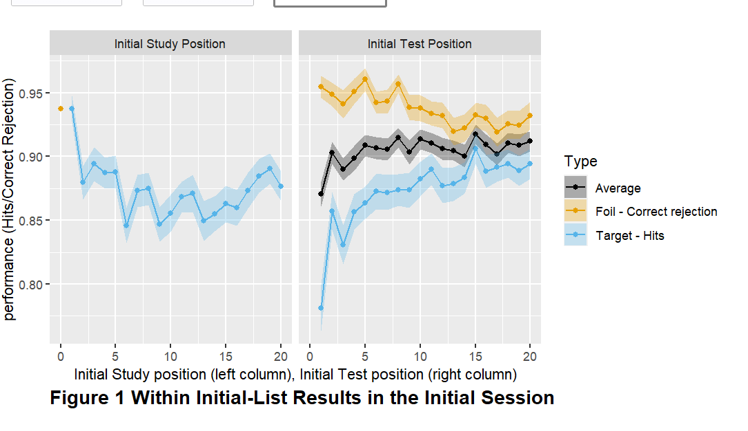
Within list results during Initial Testing:
Notes:
Point to the dot while presenting the left column panel, make sure say black is average

Slide 18
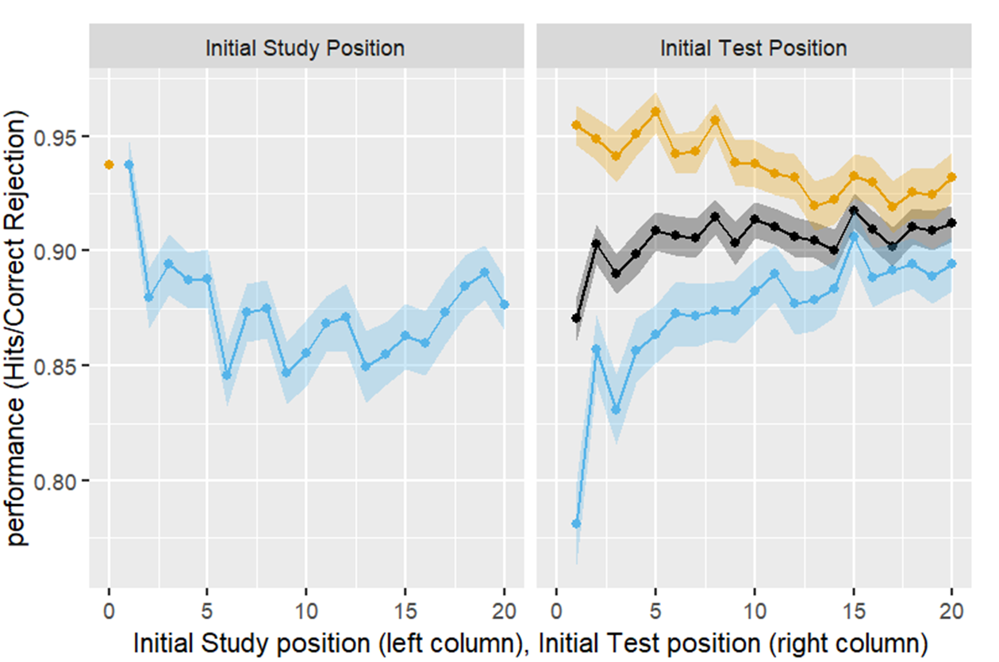
Within list results during Initial Testing
Primacy and Recency Effects (Study position)
Analysis by study position shows some primacy and a small amount of recency.
Output Interference (OI; Test position)
No evidence of OI for the 10 target and 10 foil tests for pictures.
Previous research found strong OI for words with more than ten tests.
Higher CRs than Hs
Higher correct responses to foils ('correct rejections' or CRs) than to targets ('hits' or Hs).
Difference decreases as testing continues.
Notes:
Strengthening predict output interference
Reasons to strengthen: answer list strengthen effect
(Criss, Malmberg, Shiffrin, 2011)
(Kilic, Criss, Malmberg, Shiffrin, 2017)

Slide 19
Current Model -- Storage During Testing
Storage of Information During Testing
Tests judged NEW cause storage of a new trace.
Tests judged OLD often involve trace recall, which is strengthened by adding information from the test item (Criss, Malmberg & Shiffrin, 2011; Kilic, Criss, Malmberg & Shiffrin, 2017).
REM (1997)
Strengthening a trace reduces its similarity to different test items tested later.
This shift increases correct rejections and decreases hits for later items.
🡪 Lower similarity, lower odds, lower Hs, higher CRs
Adding a Filter
A filter prevents activation of traces that poorly match the probe in context and content.
Strengthened traces become less similar, so the filter tends not to activate them.
This could potentially decrease correct rejections, increase hits, and amplifies these effects as testing continues.

Slide 20
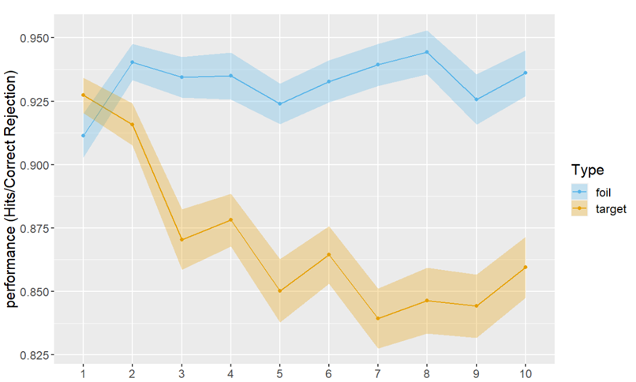
Between-List Results during Initial Testing
Performance Decline Over Lists
There is a decrease in Hs.
The decrease in Hs may be due to the activation of traces from prior lists. (Aligned with Osth and Denis’s work on “context noise” from prior lists)
The reason this decline is observed only for hits depends on the specifics of how the REM model is extended.
REM Model Predictions
REM generally predicts that correct rejections (CRs) will be higher than hits (Hs) on average.
List number in initial test
Notes:
Intiial lack an “L” here.
Fix the plot here.
Osth, Denis, have been looking list length effect, and this kind of interference is called by “context noise” from prior lists.
Our model assume accumulated tarces, activate item from prior lists

Slide 21
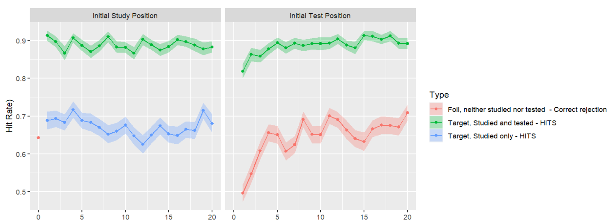
Within-List Final test results - Averaged across 3 groups
Initial Study Position
Initial study position has little impact on final testing performance.
Initial Test position
Items tested later in each list are better recognized in final testing.
Possible reason: Targets tested later may have a higher chance of recalling their trace due to associations with pictures recalled earlier in testing.
Notes:
Ask for potential interpretations , (FIT Kahana group’s work)

Slide 22
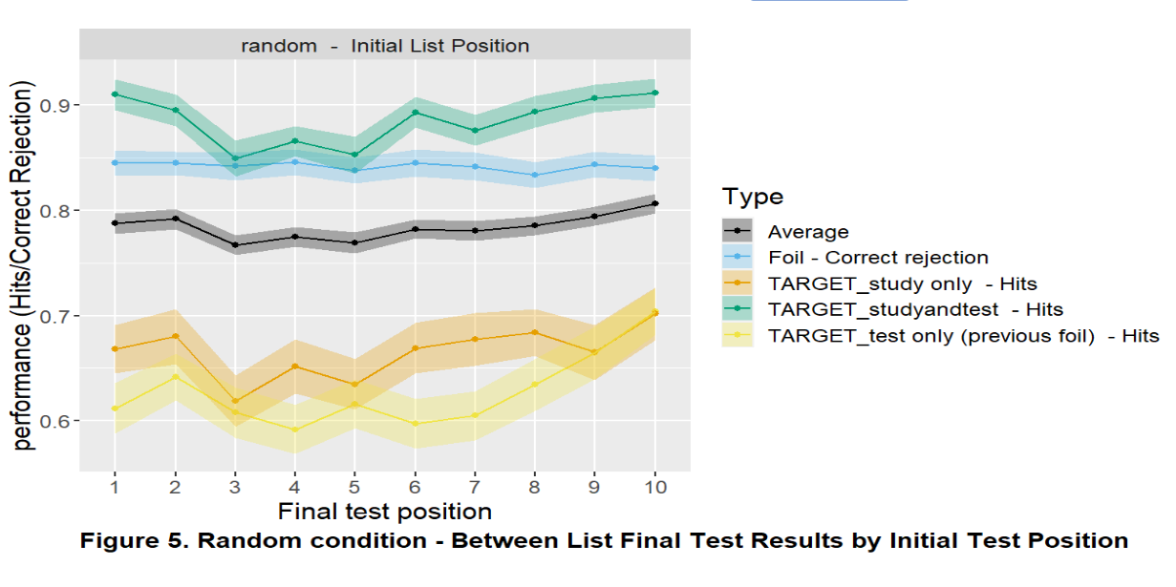
Between List Final Test Result (by initial list position)
Arranging by Initial list position for random condition best shows primacy/recency effect
Modest primacy and recency effects.
Striking observation
Pictures studied only and tested only earlier show similar, poor performance.
Suggests both produced similar strength traces—one during study, the other during testing.
Superior performance for study and tested
Items both studied and tested perform much better.
Likely due to trace storage and strengthening during testing.
Initial List Position

Slide 23
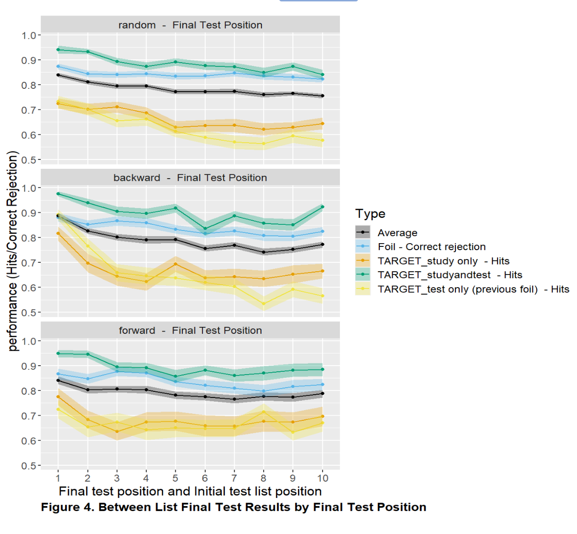
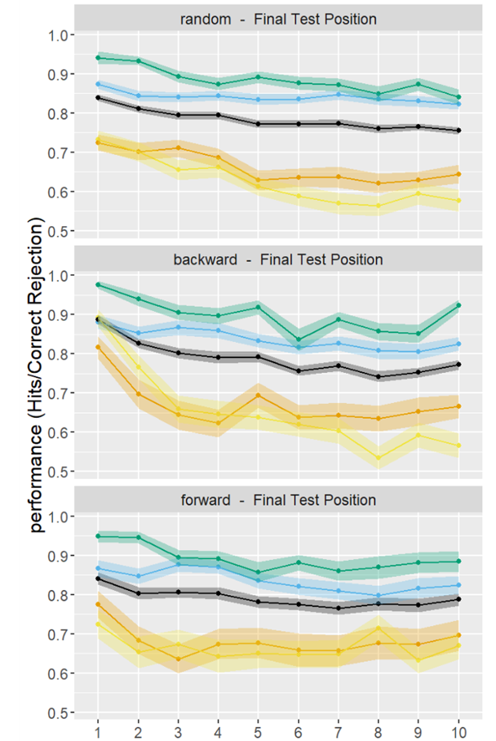
Between-List Final Test Result (by final test position)
Output Interference (OI)
Analysis by final testing position shows output interference (OI), as expected.
Differences in OI
Some differences in OI observed between random, forward, and backward conditions.
These differences might suggest the use of different context cues in each condition.
Need for Further Modeling
The existence and significance of these effects require careful modeling to be established.
List 10, 9, …., 2, 1
List 1,2, …., 9, 10
Final Test Position

Slide 24
Plans for additional studies:
Current Progress: Analysis and modeling of Studies 1 and 2 likely sufficient for the dissertation.
Focus: REM model has been effective in recognition, extending it to cued recall is a significant task.
Planned Additional Study:
Objective: Further investigate the role of context in memory storage and retrieval in combination of recognition and cued recall.
Design: Initial testing and final testing will differ in task type.
Condition 1: Recognition study (similar to Study 1) but using word lists.
Condition 2: Initial cued recall, followed by final recognition.
Condition 3: Initial recognition, followed by final cued recall.

Slide 25
Main Themes of the Current Thesis
Empirically exploring the role of context. Employing new experimental designs to investigate the changes and roles of context, aiming to generate meaningful empirical findings.
Extend the REM recognition model by adding components that are missing, and are necessary to predict the new data, and by explicitly incorporating context.
Extend the REM model to handle cued recall, the role of context in cued recall, the results of the new studies, and do so in a way that uses processes in common between the recognition and recall models.

Slide 26
Conclusion
Key Findings:
Context plays a critical role in both memory storage and retrieval.
Initial studies on recognition and cued recall provide valuable insights into the interaction between context and memory performance.
Modeling Contributions:
The REM model has been successfully extended to account for recognition data, with ongoing work to adapt it for cued recall.
Further refinements to the model will better predict memory performance across tasks.
Future Directions:
Proposed new study will further explore the role of context, combining both recognition and cued recall.
Additional studies may be needed to refine and validate the extended model.
Overall Goal:
Develop a unified, context-sensitive model of memory that applies to both recognition and recall tasks.

